Slide 1




Project EDDIE: Soil Respiration
Nave, L.E., N. Bader, and J.L. Klug. 25 June 2015. Project EDDIE: Soil Respiration. Project EDDIE Module 9, Version 1. http://cemast.illinoisstate.edu/data-for-students/modules/soil-respiration.shtml.
Module development was supported by NSF DEB 1245707.

Slide 2
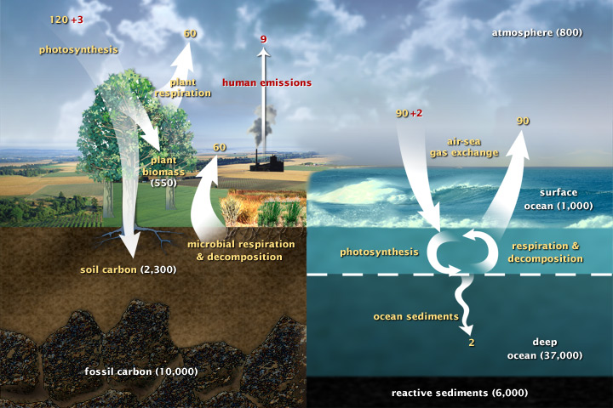
The global C cycle
http://earthobservatory.nasa.gov/Features/CarbonCycle/
Notes:
Soil respiration is a major C flux acting on the largest terrestrial C pool.

Slide 3
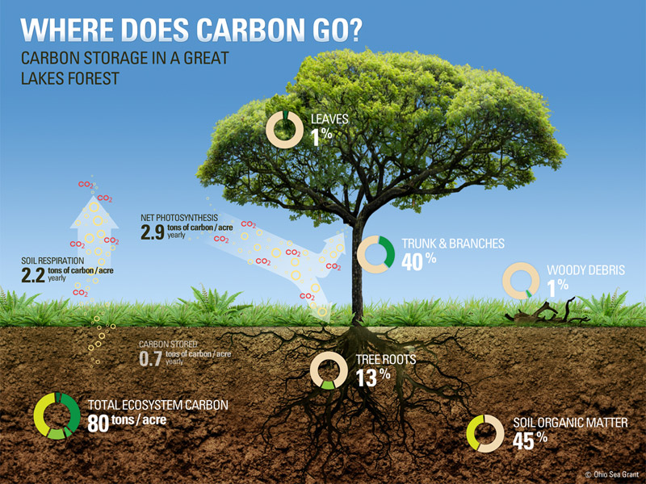
http://changingclimate.osu.edu/features/accounting-for-carbon
Notes:
Most of the C that enters an ecosystem through photosynthesis is ultimately lost via soil respiration!

Slide 4
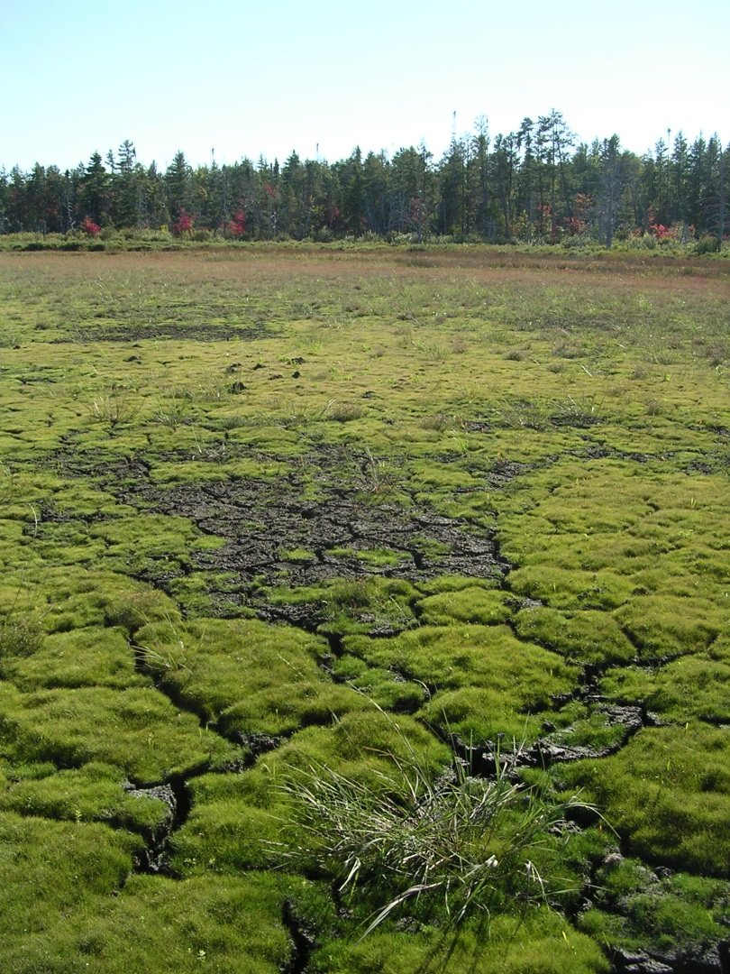
What is soil respiration?
What is happening in soil that generates CO₂?
cellular respiration by micro- and macroorganisms
Why does CO₂ flow from soil to atmosphere?
physical chemistry: gases diffuse from areas of high to low concentration
Photo by L. Nave
Notes:
What is soil respiration? The emission of carbon dioxide (CO2) from the surface of the soil.
What is happening in soil that produces CO2? Aerobic respiration. Roots, microorganisms (e.g., fungal hyphae, bacterial cells), macro organisms (e.g., insects, salamanders) and other organisms break down C-containing compounds for energy and release CO2 during cellular respiration.
Why does the soil emit CO2? CO2 is a gas whose behavior is subject to laws of physical chemistry, and as such it diffuses from areas of high concentration (in soil pore spaces) to areas of relatively low concentration (the atmosphere).

Slide 5
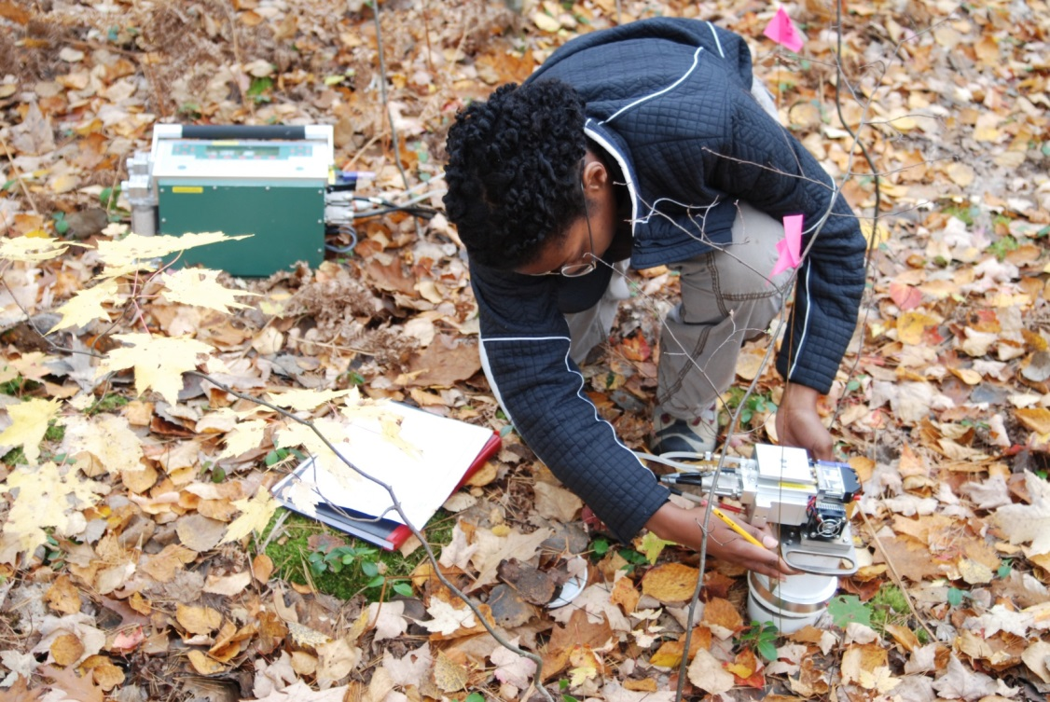
How is soil respiration measured?
Infrared gas analyzer (IRGA)
CO₂ absorbs IR (it’s the reason we have a greenhouse effect and a habitable planet!)
Pass a known wavelength of IR through a known volume of air, measure IR on the other side, absorbance of IR is proportional to concentration of CO₂
Integrate measurement over time at high frequency to calculate a rate of CO₂ emission per area per time
Photo by L. Nave
Notes:
How is soil respiration measured? CO2 absorbs infrared radiation (aka longwave; heat). This physical property is important globally because it drives the greenhouse effect- if not for the presence of CO2 and other greenhouse gases in Earth’s atmosphere, we would lose so much of our outgoing infrared radiation to space that ambient temperatures would be inhospitably cold to life as we know it. At the same time, increasing the CO2 concentration of the atmosphere is increasing the retention of heat in Earth’s energy budget, which is causing climate change. Back to the question at hand, the fact that CO2 absorbs infrared energy is what is used to measure its concentration in an atmosphere of any size. To measure soil respiration, a container or lid of a known volume is placed on top of the soil. As the volume of air inside the container (called the “headspace”) fills up with CO2 over the course of several minutes, a pump is used to circulate the mixture of headspace gases through an infrared gas analyzer (IRGA). The IRGA passes controlled pulses of longwave radiation through the headspace gas, and by measuring how much longwave radiation is absorbed, it measures the amount of CO2 in that mixture of headspace gases. By measuring the concentration of CO2 in the headspace repeatedly, many times per second over several minutes, it is possible to calculate the amount of CO2 moving from the soil into the headspace per second, or per minute, per hour, etc.

Slide 6
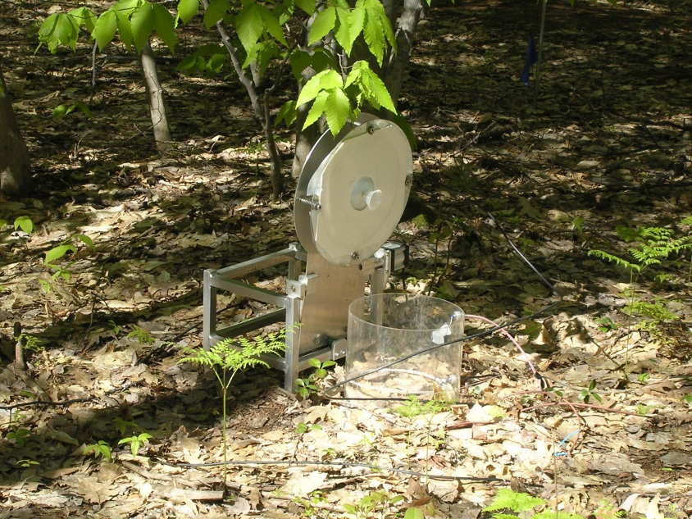
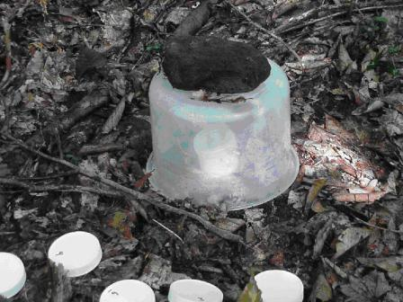
How is soil respiration measured?
Automated tools also measure soil respiration (using same principles)
Older techniques used stoichiometric reaction (mass change) in soda lime (calcium sodium hydroxide) when exposed to emitted CO₂
http://www.ecoplexity.org/?q=node/551

Slide 7

What controls soil respiration rates?
The types and abundance of soil organisms that emit CO₂: plant roots, fungi vs. bacteria, micro- and macroarthropods
Availability and types of C substrates: roots respire sugars and starches, macroarthropods eat plant litter, fungi and bacteria decompose soil organic matter
Photo by L. Nave
Notes:
What factors control the rate at which CO2 is generated in the soil by the organisms inhabiting it? The availability of C substrates for breakdown via aerobic respiration, the types and number of organisms present in the portion of soil being measured, the environmental factors that control the metabolic activity of organisms (e.g., temperature, water and nutrient availability).

Slide 8

What controls soil respiration rates?
Temperature and moisture control soil organisms’ metabolic rates
Availability of nutrient elements, e.g., N, P, Ca
Soil physics: soil porosity influences the concentration gradient and diffusion rate of CO₂ up through the soil profile
Photo by L. Nave
Notes:
Other details: The porosity of the soil, the concentration gradient (difference in CO2 concentration) between the soil and the atmosphere.

Slide 9
Measurement errors, sources of uncertainty and variation
What factors may cause problems getting a high- confidence measurement of soil respiration?
Physical problems with measurement system- electrical problems, software problems, ants in the gas tubes…
Spatial variability- earthworm burrows are CO₂ chimneys, mushrooms are CO₂ “smokestacks,” dead roots vs. live roots, microbial “hotspots”
Temporal variability- warmer soils by day, colder soils after cold snaps, rainfall events, droughts…
Notes:
What factors might make it difficult to measure soil respiration, or might result in flawed or false readings of soil respiration? Measuring soil respiration is difficult when the factors that limit organismal metabolism are highly constrained, resulting in very low rates of CO2 emission (which are difficult to measure against the background concentration of CO2 in the atmosphere). E.g., when soils are very cold, or dry, have few organisms, or lack nutrients that are required for metabolic processes. Flawed and false respiration measurements can come from measuring only a few, small portions of the soil and failing to capture the spatial variation in soil respiration rates. For example, an animal burrow or a mushroom acts as a “CO2 chimney” by funneling CO2 from a large area into a small exit location, and similar “patchiness” in soil respiration rates can result from soil microtopography (e.g., moist patches vs. dry patches) or uneven heating (sun flecks).

Slide 10
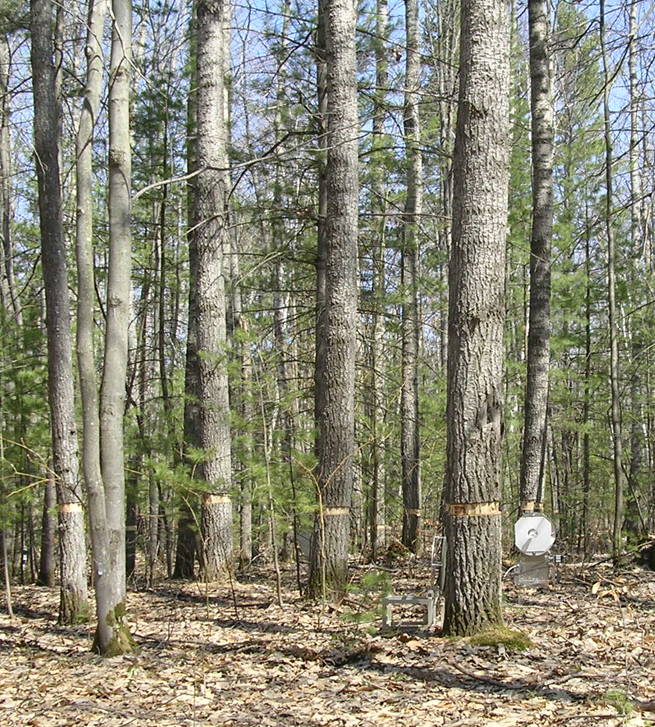
Testing sources of variation
How can we test sources of variation to figure out what is driving soil respiration rates?
Concurrent measurements- e.g., of soil temperature, moisture
Experiments- e.g., girdle trees to prevent movement of sugars from leaves to roots
Photo by L. Nave
Notes:
How can we be sure that our measurements are accurate- that they really represent reality and can tell us how much CO2 is being emitted from the soil per second, hour, or day? Make many measurements across a study site, and verify that they are consistent- if variation among measurement locations is high, more samples are needed to constrain the true amount of CO2 being emitted by the soil. Likewise, make frequent measurements over time and inspect the data to be alert for sudden changes.

Slide 11
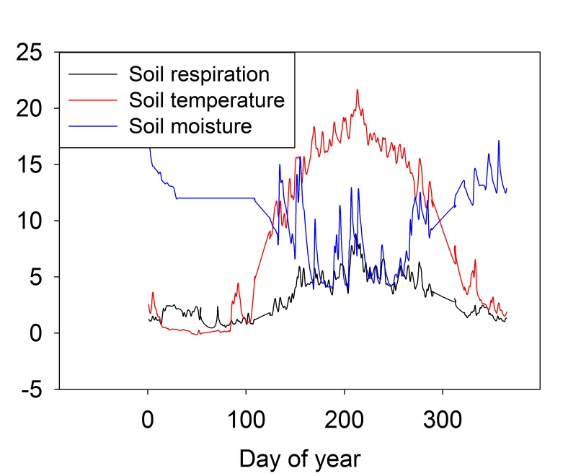
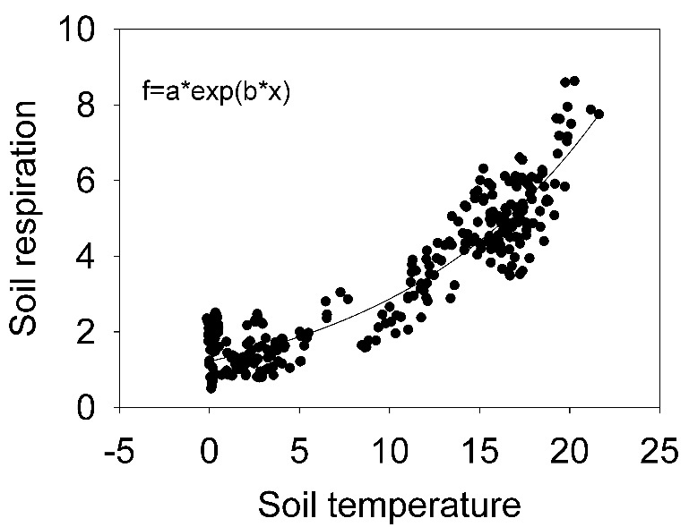
Testing sources of variation
How can we use measurements of other variables or experiments to identify and quantify sources of variation?
Pattern analysis- e.g., look at graph of soil respiration rates over the year, compare visually to graph of temperature
Statistical testing- use correlation or regression analysis to quantify the relationship (equation) between temperature and soil respiration
Notes:
If there is a sudden change, or a change over time, ask whether that change might be correlated with some driver of soil respiration, like environmental conditions, or if it appears to be unrelated to any potential drivers (in which case it might indicate an electrical or physical problem with the measurement system).
Measure soil respiration repeatedly at a number of sites, and for every measurement of soil respiration make a co-located, contemporaneous measurement of the environmental factors that might be driving the changes in soil respiration over time. Use statistical tests, such as correlation analysis or regression, comparison of averages or variances to identify whether factors hypothesized to be drivers of soil respiration are indeed related to variation in soil respiration. Another approach is through experimentation. For example, if it is believed that the supply of C-containing compounds to roots (i.e., sugars from photosynthesis) is the main driver of soil respiration in a place, dig trenches or insert deep cores into the ground to sever the roots. Measure soil respiration over weeks to months as the roots die and determine whether separating the roots from the trees that feed them changes the soil respiration rate.

Slide 12
Why is soil respiration important, in terms of the C cycle of a forest, or a region, or the entire globe?
The emission of CO2 from the soil accounts for roughly half of the total emissions of CO2 from terrestrial ecosystems!
Factors that change the rate of CO2 emission from soil can:
change the C budget of a forest from being a C sink (net removal of CO2 from the atmosphere, counteracting the greenhouse effect and climate change)
to a C source (net emission of CO2 from forest to the atmosphere and a positive feedback to atmospheric C pollution and climate change).

